Slide 1
Sex Education
Protection for Male Bodies
Special thanks to University Hospitals, Cleveland, OH

Slide 2
Goals
What is consent?
How do I make sure I have it?

Slide 3
Why “male bodies”?
Anyone with a penis
Boys
Men
People born with multiple sex organs (e.g. penis and vagina)
People who had gender-affirming surgery

Slide 4
How to put on a condom (the right way)
Getting it wrong makes a huge difference

Slide 5
Step 1?

Slide 6
Step 1: Check the expiration date
All condom wrappers have an expiration date printed on them
Over time, the condom rubber breaks down and gets micro-tears
If expired, THROW IT OUT

Slide 7
Step 2?

Slide 8
Step 2: Check the air bubble
All condoms have an air bubble in them
Squeeze to make sure there aren’t any holes
If no air bubble, THROW IT OUT

Slide 9
Step 3?

Slide 10
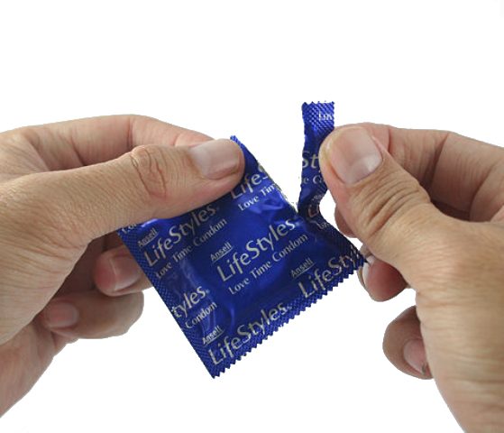
Step 3: Open the package
Carefully!
No scissors/knives
No teeth
Push the condom over to one side
Gently tear the corner away from the condom
Gently pull to open

Slide 11
Step 4?

Slide 12
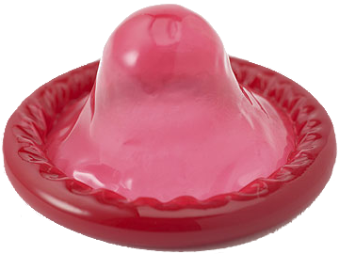
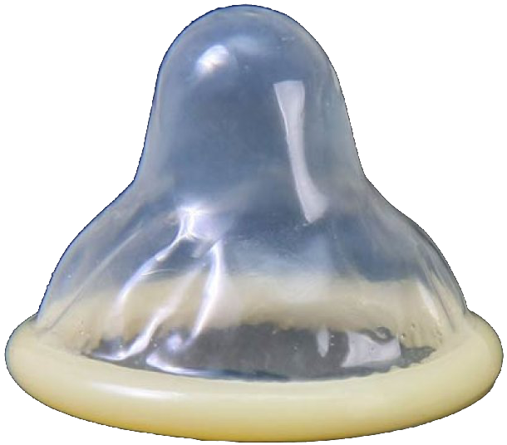
Step 4: Check if it’s inside-out
Tip should be coming from the inside
Looks like a sombrero, not baby bottle top
Won’t roll on the wrong way
What if you accidentally try to put it on inside out? THROW IT OUT
✓
✗

Slide 13
Step 5?

Slide 14
Step 5: Squeeze the tip
Squeeze the air out of the tip
As much as possible!
Need a place for semen to go, so it doesn’t pop or spill out the sides

Slide 15
Step 6?

Slide 16
Step 6: Roll it on
(As far down as possible)

Slide 17
Recap
Check the expiration date
Check the air bubble
Open the package
Check if it’s inside-out
Squeeze the tip
Roll it on

Slide 18
How do I pick the right size/brand?
There’s no such thing as too small!
They’re basically all the same
But different shapes, materials, colors, lubes, etc.
If possible, avoid ones with spermicide
The spermicide eats away at the plastic over time

Slide 19
What if it’s too small?

Slide 20
Two condoms?
No!
They will rub against each other and micro-tear!
Rub your hands together
Feel the heat?
That’s what will happen and the heat will make tiny holes in the condoms

Slide 21
Lube?
Yes!
Lube helps the condom slip
Less friction → less heat → less chance of tearing
How much?
Can’t go wrong
What kind (water-based, oil-based)?
Don’t use oil-based with latex condoms

Slide 22
Fun fact!
Condoms can be made into dental dams
Cut halfway with scissors
Unroll
Use for protection during oral sex
✃

Slide 23
Questions?

